Slide 1
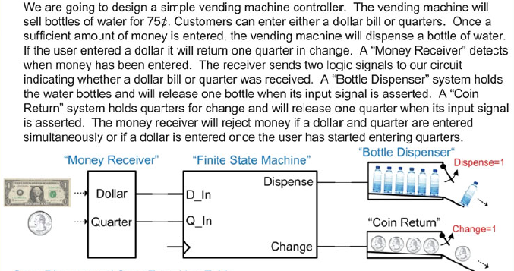
Lab 25. Design of the Vending machine

Slide 2
Lab. Design of the Vending machine
State:
Input:
Output:

Slide 3
Requirement
After defining the state, input and output, draw the state diagram and create the state table, using K-map to simplify the circuit.
After I verify your result is correct, I’ll let you know the simulation configurations.
Hint: three states using BCD codeword(00,01,10)

Slide 4
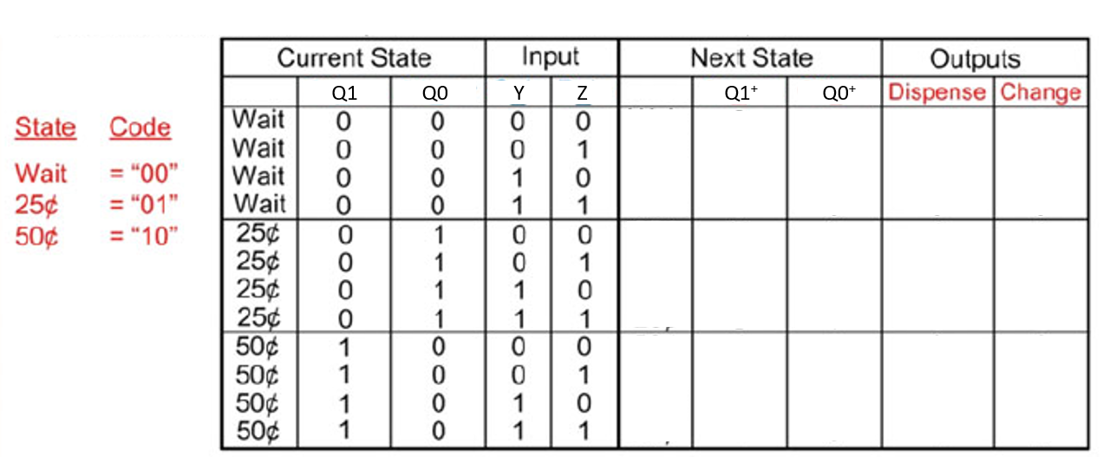

Slide 5
Lab. Design of the Vending machine
Draw the circuit diagram
Implement the circuit in Simulink
^{1. Pulse wave generator for Y:}
sample based, amplitude=1, period=10, pulse width=7, phase delay=0, sample time=1
^{2. Pulse wave generator for Z:}
sample based, amplitude=1, period=10, pulse width=6, phase delay=10, sample time=1
3. Pulse wave generator for clock signal:
sample based, amplitude=1, period=2, pulse width=1, phase delay=1, sample time=1
4. Observe the result on a scope:
Scope has 7 input ports for: clock signal, Y, Z, Q1+, Q0+, change, dispense
5. Simulation time duration: 7s

